Slide 1

Amazon Web Services
workshop
for System Engineer
Using Amazon Simple Storage Service (S3) and Amazon CloudFront

Slide 2
Topics
Understand of Amazon Simple Storage Service
S3 Use Cases
Understand of Amazon CloudFront
S3 Lab, CloudFront Lab

Slide 3
Objectives
You will be able to
Describe what is Amazon S3 and its use cases.
Create Buckets and upload files to S3.
Set basics permissions, versioning, and share objects on S3
Delete S3 Buckets.
Create Amazon CloudFront to distribute and caching Amazon S3 bucket.

Slide 4


Introduction to S3

Slide 5
Amazon Simple Storage Service (S3)
Amazon Simple Storage Service (Amazon S3), provides developers and IT teams with secure, durable, highly-scalable object storage. Amazon S3 is easy to use, with a simple web interface to store and retrieve any amount of data from anywhere on the web.
Amazon S3 can be used alone or together with other AWS services such as EC2, EBS, and Amazon Glacier, as well as third party storage repositories and gateways.
Amazon S3 provides cost-effective object storage for a wide variety of use cases including cloud applications, content distribution, backup and archiving, disaster recovery, and big data analytics.

Slide 6
Amazon Simple Storage Service (S3)
Durable, scalable object store.
Store and retrieve any amount of data, anytime, from anywhere on the web.
Store data with up to 99.99999999999% durability, with 99.99% availability.
Store objects in buckets and retrieve using a unique developer assign key.
Store buckets in one of several AWS Regions.

Slide 7
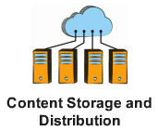
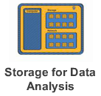
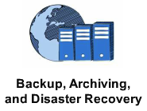
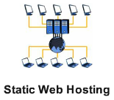
AWS S3 Use Cases
Use S3 to offload your entire storage infrastructure into the cloud to handle your glowing storage needs. You can distribute your content directly from S3 or store for pushing content to CloudFront Edge Location
Store data for analysis such as financial data for computation and pricing or photo imaged for resizing and send this content to EC2 to do the computation works without incurring any data transfer charges for moving data between the services.
Use S3 Versioning, high durable, scalable and secure, capability to provide backup and archiving critical data. You can define rules to archive sets of S3 objects to Glacier based on it’s lifetime.
Use S3 to host entire static website to meets traffic demands. You can reliable serve your traffic and handle unexpected peaks without worrying about scaling your infrastructure.

Slide 8

Case Study:

Slide 9
AWS S3: Basics
Amazon S3 stores dat as object within Buckets. An object comprised of a file and optionally any metadata that describe the file.
To store an object in S3, you upload the file you want to store to a bucket. When you upload a file, you can set permission on the object as well as metadata.
Buckets are the container for objects. You can have one or more buckets. For each bucket, you can control access to the bucket (who can create, delete, and list objects in the bucket), view access logs for the bucket and its objects, and choose the geographical region where Amazon S3 will store the bucket and it contents.
When using Amazon Management Console, you can create folders to group objects, also folders within folder.
You can store file from 1 byte to 5 Terabytes each with unlimited number of objects. Each object is stored in a bucket with a unique key that you assign.

Slide 10
AWS S3: Prices
You are not charged for creating a bucket; you are only charged for storing objects in the buckets.
Amazon provided free tier for S3 within certain usage limits.
12 months after you sign in. No upfront cost.
5GB of Standard Storage.
20,000 GET requests.
2,000 POST Requests.
15GB of data transfer out each month for one year.

Slide 11
AWS S3: Storage Pricing
 | Standard Storage | Reduced Redundancy Storage
First 1TB / month | $0.0300 per GB | $0.0240 per GB
Next 49 TB / month | $0.0295 per GB | $0.0236 per GB
Next 450 TB / month | $0.0290 per GB | $0.0232 per GB
Next 500 TB / month | $0.0285 per GB | $0.0228 per GB
Next 4000 TB / month | $0.0280 per GB | $0.0224 per GB
Over 5000 TB / month | $0.0275 per GB | $0.0220 per GB
http://aws.amazon.com/s3/pricing/
*** Jan 2015, prices for Asia Pacific (Singapore) Region

Slide 12
AWS S3: Request Pricing
Method | Pricing
PUT, COPY, POST, or LIST Requests | $0.005 per 1,000 requests
Delete Requests | Free (No charge for delete requests of Standard or RRS objects.)
GET and all other Requests | $0.004 per 10,000 requests
http://aws.amazon.com/s3/pricing/
*** Jan 2015, prices for Asia Pacific (Singapore) Region

Slide 13
AWS S3: Transfer Pricing
Data Transfer IN To Amazon S3 | Pricing
All data transfer in | $0.000 per GB
Data Transfer OUT From Amazon S3 To
Amazon EC2 in the same region | $0.000 per GB
Another AWS Region | $0.090 per GB
Amazon CloudFront | $0.000 per GB
Data Transfer OUT From Amazon S3 To Internet
First 1 GB / month | $0.000 per GB
Up to 10 TB / month | $0.120 per GB
Next 40 TB / month | $0.085 per GB
Next 100 TB / month | $0.082 per GB
Next 350 TB / month | $0.080 per GB
Next 524 TB / month | Contact Amazon
Next 4 PB / month | Contact Amazon
Greater than 5 PB / month | Contact Amazon
http://aws.amazon.com/s3/pricing/
*** Jan 2015, prices for Asia Pacific (Singapore) Region

Slide 14
Amazon CloudFront
Amazon CloudFront is a content delivery web service. It integrates with other Amazon Web Services products to give developers and businesses an easy way to distribute content to end users with low latency, high data transfer speeds, and no minimum usage commitments.
Amazon CloudFront can be used to deliver your entire website, including dynamic, static, streaming, and interactive content using global network of Edge Locations.
Requests for your content are automatically routed to the nearest Edge Location, so content is delivered with the best possible performance.
Amazon CloudFront is optimized to work with other AWS, like S3, EC2, ELB, and Amazon Route 53, and also works seamlessly with any non-AWS origin server.

Slide 15
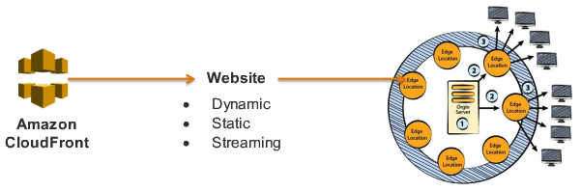
Content Delivery with Amazon CloudFront
Can be use to delivery your website, including dynamic, static and streaming content using a global network of edge locations.
Requests for your content is delivered with the best possible performance.

Slide 16

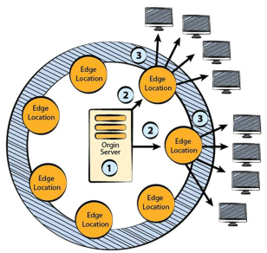
Amazon CloudFront
Global Content Delivery Network
Cache content at edge locations.
Closer to users around the world.
Use Amazon S3 or custom origin.
Integrates with other AWS Services.
Distribute content to end users with low latency, high data transfer speeds, an no commitments.

Slide 17
Lab: Introduction to S3 and CloudFront
Overview
This guide introduces you to Amazon Simple Storage Service using the AWS Management Console and distribute content to AWS CloudFront.
2 labs.
Topics Covered
Create a Bucket in Amazon S3.
Adding objects in Amazon S3.
Viewing and download objects in Bucket.
Optional Deleting objects from a Bucket in S3.
Create AWS CloudFront.
Distribute contents to Edge Locations.

Slide 18
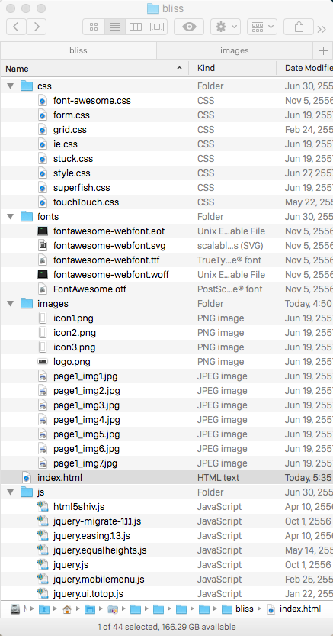
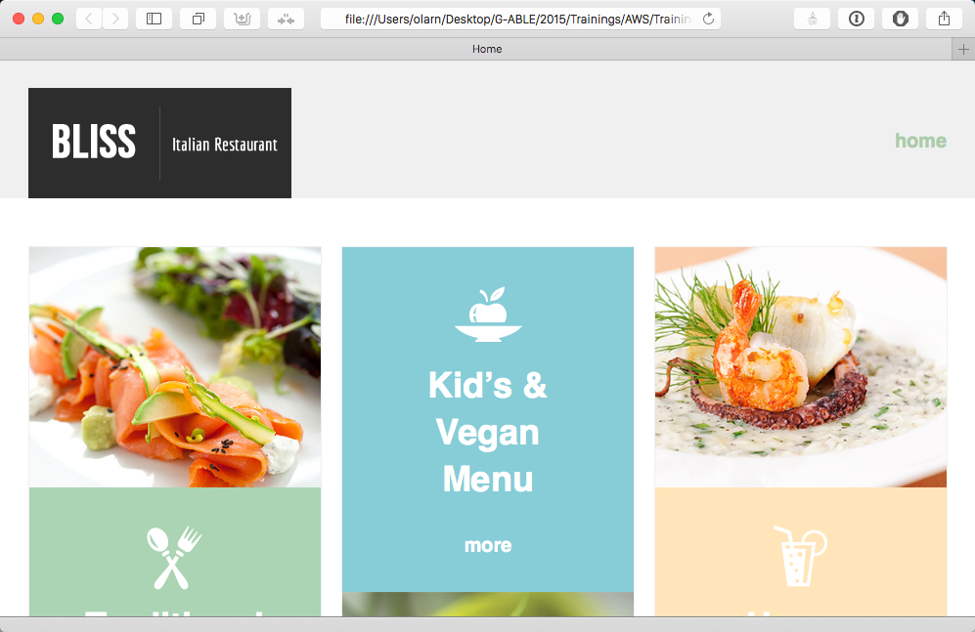
Lab: Resources

Slide 19
Lab1-2: Login to AWS Console
Goto https://console.aws.amazon.com, enter AWS username and password and then click “Sing in using our secure server” button.
In AWS Console, click S3 link under Storage & Content Delivery group to open S3 service console.

Slide 20
Lab1-2: Create S3 Bucket
Click Create Bucket. A dialog will open, in the Bucket name box, enter bucket name with pattern <yourname>-bucket and change the Region to Singapore Note: after create a bucket, you cannot change its name. In additional, the bucket name is visible in the URL that point to the objects stored in the bucket. The bucket name must be unique in the region.
Click Create. Note: If you click the bucket name, you will be navigated inside the bucket. If you click besides of bucket name, console will open the bucket properties.
In S3 console. Expand Logging, click Enable, choose <yourname>-bucket in Target Bucket drop down list, then click Save.
Expand Versioning, click Enable Version Button. Note: Versioning-enabled buckets store all versions of your objects by default. Once enabled, Versioning cannot be disabled, only suspended.

Slide 21
Lab1-2: Add an object into S3 Bucket
Click the bucket.
Inside your bucket, click Create Folder button, named the folder images and press Enter (or Return).
Click the images link to get inside the folder. Click Upload button, a upload dialog will appear,
Click Add Files button, navigates to folder images insides bliss folder, select all files then click Choose button. Note: You can choose multiple files at a time by hold Control button and click each file, or click on the first file then hold Shift button on keyboard and click on the latest file to select all.
Click Start Upload button. You can see the progress of the upload from within the Transfer panel.

Slide 22
Lab1-2: To Download object
To make files downloadable (or public), click <yourname>-bucket to navigate outside folder images, then select folder images (click the checkbox).
From Action menu button, click then select Make Public, click OK on dialog box. You will see the progress on the right panel.
Click folder images to get inside again.
Select any file, while your public object is selected, click Properties button, you will see Link property. Copy the link and paste url in the address box in other browser, it should open or download the file depends on your file type.
Choose any file in your bucket, click Action button and then choose Download. A download dialog box will appear, click Download link to download the file. Note: To remove public access to the file you choose in step 12, choose the file and open Properties button, expand Permissions. Remove grantee “Everyone” by click the X button on the most right hand side of the permission, then clic Save button. Repeat step 13 again, the file will become private and you can see access denied message in the browser. Note: You can move object to another folder by right click the object you want to move then goto destination folder, right click and choose “Paste”. Delete object by choose from Action menu or right click also.

Slide 23
Lab1-2: Delete Bucket
(skip this step) To delete Bucket. First you have to delete all objects inside the Bucket (you can use Shift-click to choose group of objects). Then goto All Buckets, click the row of Bucket you want to delete, click Action button and choose Delete, Click ok in the confirmation dialog. Note: You cannot delete Bucket if your Bucket or some files in the Bucket enable Versioning (all history files are hidden by default), so you have to remove all Versioning history first. To delete history files, click Show button inside Bucket console then choose Delete from Action menu.

Slide 24
More about S3 Bucket and CloudFront
An Amazon S3 bucket is a container that can hold objects or folders. Amazon CloudFront can distribute almost any type of object that an Amazon S3 bucket contains, for example, text, images, and videos. You can create multiple buckets, and there is no limit to the amount of data that you can store on Amazon S3.
By default, your Amazon S3 bucket and all of the objects in it are private - only the AWS account that created the bucket has permission to read or write the objects in it.
If you want to allow anyone to access the objects in your Amazon S3 bucket using Amazon CloudFront URLs, you must grant public read permissions to the objects. This is one of the most common issues when working with Amazon CloudFront and Amazon S3. You must explicit grant privileges to each object in an Amazon S3 bucket.

Slide 25

Lab 2-2: Create CloudFront Content Distribution
Click Services menu on the top of AWS console. Choose Storage & Content Delivery, click CloudFront.
1
2
3

Slide 26
Lab 2-2: Create Distribution
In the AWS CloudFront Distribution Console, click Create Distribution button.
Step 1: Under the Web section, click Get Started.
Step 2: Click in the Original Domain Name box, the drop-down list appears, choose <yourname>-bucket under Amazon S3 Buckets group. Note: By default, objects will be cached on Amazon CloudFront 24 Hours (For more details, see references link at the end of this document).
Click Create Distribution button. Note: After Amazon CloudFront created your distribution, the value of the Status column for your distribution will change from InProgress to Deployed. This should take less than 15 minutes. Note: The Domain Name that Amazon CloudFront assigns to your distribution appears in the list of distributions. It will looks similar “dpj0xjbyj7uhb.cloudfront.net” it also appears on the General tab under Distribution Settings for selected distribution.

Slide 27
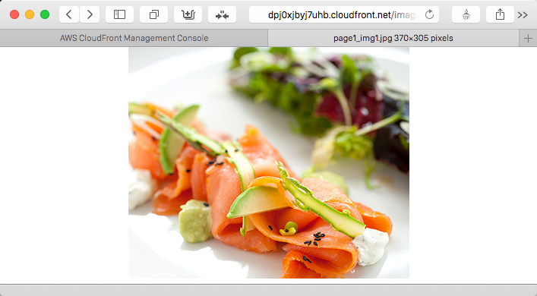
Lab 2-2: Create Distribution
Try to open image file by append the CloudFront url with “images/page1_img1.jpg” for example :- http://dpj0xjbyj7uhb.cloudfront.net/images/page1_img1.jpg You should see the image appear in your browser.
Note: The distribution process
may take sometimes, skip this step and comeback to try it later.

Slide 28
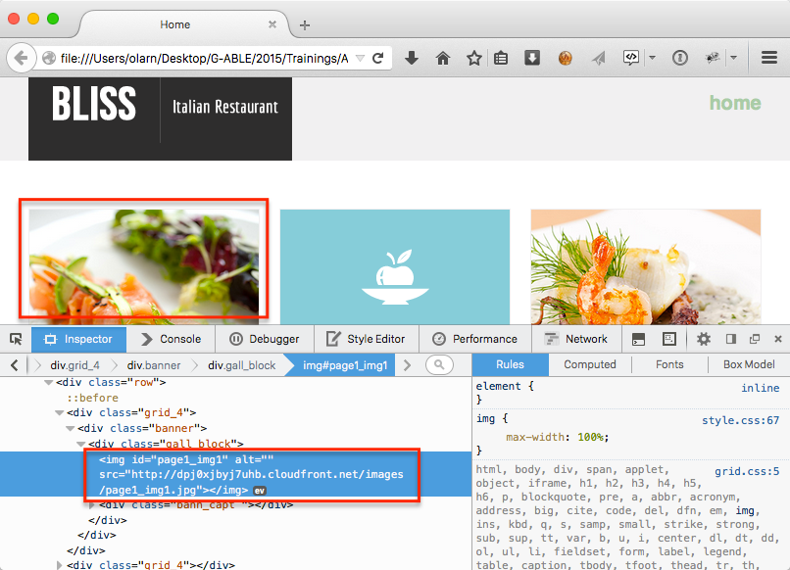
Lab 2-2: Update html documents
Open bliss’s index.html file with your html editor (like Sublime or Atom).
Change the value of variable named cloudFrontUrl (line 33rd) to http://<your_cloudfront_url>/images/
Save index.html and open with browser, you should see the full webpage if your contents already distributed with Amazon CloudFront.
Right-click on any image, and select Inspect Element menu (for Firefox, Safari, and Chrome). You can see image’s url referred to Amazon CloudFront’s DNS name.

Slide 29
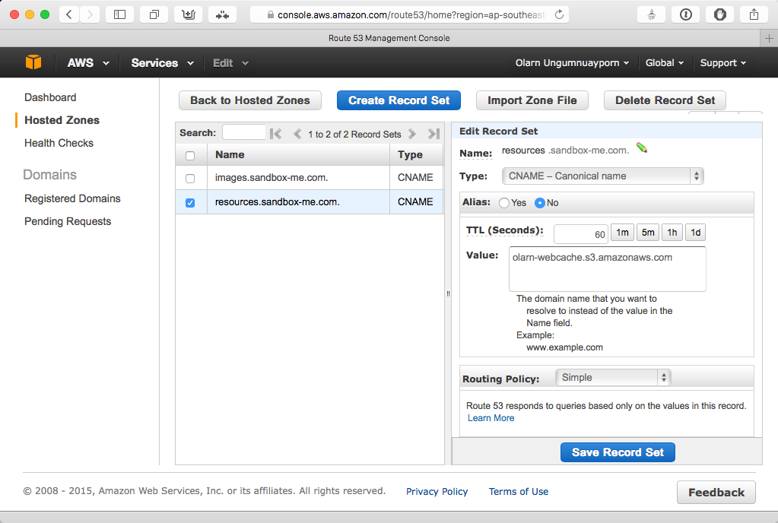
Binding CloudFront with Route 53
If you want the URL for the object/images/image.jpg to look like this: http://www.example.com/images/image.jpg, you would create a CNAME for www.example.com and point destination to the CloudFront DNS name.
You can create up to 10 CNAMEs per distribution. You also need to create (or update) CNAME record with your DNS service to route queries.
Example :- Route 53 binding to Amazon S3 bucket and CloudFront with SNAME

Slide 30
Conclusion
Amazon S3 provides developers and IT teams with secure, durable, highly-scalable object storage.
You can use S3 to store files for sharing, versioning, and use as resources for your website or source of analytic process.
S3 provides multiple roles and level to access objects in the Cloud, and also provides 99.99999999999% durability, with 99.99% availability.
Prices are vary, lower per GB for higher scale, from free tier to pay-as-you-use. No upfront charge or fee. Depends on Storage, Request, Transfer size per month, and Region.
Amazon CloudFront distribute content to end users with low latency, high data transfer speeds, using global network of Edge Locations, and no minimum usage commitments.

Slide 31
References
Amazon S3 http://aws.amazon.com/s3
S3 Pricing http://aws.amazon.com/s3/pricing/
Amazon CloudFront http://aws.amazon.com/cloudfront/
Getting Start with CloudFront http://docs.aws.amazon.com/AmazonCloudFront/latest/DeveloperGuide/GettingStarted.html
More details about Amazon CloudFront Caching Behaviour http://docs.aws.amazon.com/AmazonCloudFront/latest/DeveloperGuide/distribution-web.html
CloudFront Pricing http://aws.amazon.com/cloudfront/pricing/

